Slide 1
Customers to Target for Marketing Efforts
Presented by: Anjali Hansda

Slide 2
Table of Contents
Customers to Target for Marketing Efforts
Objective
Methodology for Analysis
Insights from Analysis
Findings
Appendix

Slide 3
Objective
Sprocket Central is an Australian company that sells bicycles and their parts.
They have a list of 1000 new customers and they want to find out customers to target for marketing efforts.

Slide 4
Methodology
01
Customer Segments: Segmenting customers based on purchase behavior using RFM scores
02
Segment Analysis: Analyzing demographics and purchase preferences of profitable segments
03
Finding Customers: Identifying new customers resembling target segments and tailoring marketing efforts accordingly
Notes:
Based on the RFM scores the customer base is divided into 10 customer segments.

Slide 5
01
Customer Segments
Dissecting customer base into various customer segments based on purchase behaviour.
Notes:
We need to understand the types of customers and which ones are profitable. To do so we will look at their purchase behaviour and dissect them into various customer segments.

Slide 6
Understanding Aspects of Purchase Behaviour
Customers are given Recency, Frequency, and Monetary Value (RFM) scores.
Recency
Frequency
Monetary Value
How recent customer’s last order was?
How often customer placed an order?
What is the total amount of money the customer has spent?
*Refer to Appendix(Slide 26) for further explanation.
Notes:
Recency: number of days between last day of 2017 and order date. Frequency: Number of purchases in 2017. Monetary Value: Amount spent by the customer in 2017.

Slide 7
Customer Segments
Customers
Average Customers
One Time Customers
Customers who made a purchase a long time ago
Active Loyal Customers
Customers with frequent good purchases and not long ago
Slipping Best Customers
Best customers with no recent purchases
Potential Customers
Customers with recent big purchase
Notes:
Based on the RFM scores the customer base is divided into 10 customer segments.

Slide 8
Customer Segments
Best Customers
Perfect customers with good frequent and recent purchases
Churned Best Customers
Best customers with no recent purchases and churned
New Customers
Customers with recent purchases but number of purchases is low
Lost Customers
Normal and loyal customers with no purchase for a long time
Declining Customers
Customers with no recent purchases

Slide 9
Customer Count Per Segment
*Data Overview
The customers who made purchases in the year 2017 are included in the analysis.
The scope of the analysis is limited to New South Wales, Queensland, and Victoria.

Slide 10
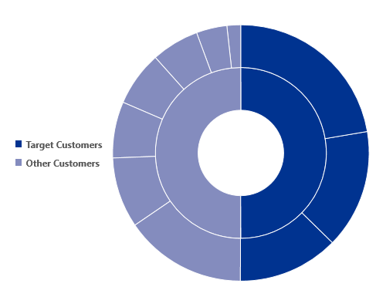
Order Value by Customer Type
Declining
Potential
One-time
Customer
New
Churned Best
Active Loyal Customer
Lost
Slipping Best
Best Customer
Order value of Target Customer Segment : $11M
50% of the Total Order Value
Notes:
Order value of almost 11 million dollars came only from the 3 segments. Which is 50% of the total order value.

Slide 11
02
Segment Analysis
Understanding the segments of Best Customers, Active Loyal Customers, and Customers with:
Customer Demographics
Purchase Preferences
Notes:
We have chosen 3 segments target for marketing efforts.

Slide 12
1. Customer Demographics
Age Distribution:
Which age group does the customer fall under?
15-24
25-34
35-44
45-54
55+
Location:
Which state does the customer live in?
New South Wales
Queensland
Victoria
Job Industry:
Which industry does the customer work in?
Financial Services
Manufacturing
Health
Retail
Property
IT
Entertainment
Agriculture
Telecommunications
Wealth Segment: Categorising customer based on financial background
Mass Customer
High Net Worth Customer
Affluent Customer
Car Ownership: Whether the customer own a car?

Slide 13
Customer Demographics
Age Distribution
The majority of the chosen customer segment falls under the 35-44 age group.

Slide 14
Customer Demographics
Location
The target segment mostly resides in New South Wales followed by Victoria.

Slide 15
Customer Demographics
Job Industry
The chosen customer segment is mostly employed in Health, Manufacturing, and Financial Services.

Slide 16
Customer Demographics
Wealth Segment
The majority of customers are in the Mass Customer Segment.

Slide 17
Customer Demographics
Car Ownership
No impact on purchase behavior can be deduced due to negligible difference.

Slide 18
2. Customer’s Purchase Preference
Brand Preference:
Understanding which brands favoured by profitable customer.
Product Line Preference:
Identifying what product line gravitates profitable customers.
Season Preference:
Recognizing seasonal trends in purchasing behaviour
Average Order Amount:
Finding average order helps in understanding price sensitivity of profitable customers.

Slide 19
Customer’s Purchase Preference
Brand Preference
The Solex Brand has the highest order volume.
Other than Solex, other brands are even in order volume.

Slide 20
Customer’s Purchase Preference
Product Line Preference
The Standard product line is most preferred among the chosen customer segment.

Slide 21
Customer’s Purchase Preference
Season Preference
There is a seasonal preference among the chosen customer segment.
The order volume tends to increase at the end of the year in the months of October, November, and December.

Slide 22
Customer’s Purchase Preference
Average Order Value
The average order value for the chosen segment is $1,102.71.
This suggests the possible price sensitivity of the chosen customer segments.

Slide 23
03
Finding Customers
Finding individuals with similar traits as target customers
Marketing Effort Recommendations

Slide 24
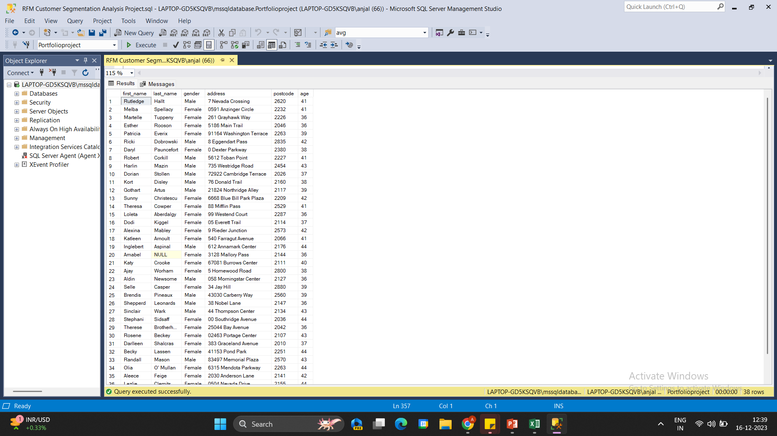
1. Probable Customer List
Age Distribution: 35-44 Age Group
Location: New South Wales
Job Industry: Health, Manufacturing, Financial Services
Wealth Segment: Mass Customer
Click to view complete list of probable customers
38 out of 1000
Individuals meet the characteristic traits of the target customer segment
Notes:
Increasing the probability that they’ll be profitable customers.

Slide 25
2. Marketing Efforts
Focusing marketing efforts more on the Solex brand and Standard product line.
Providing limited “End-of-Year Celebration” promotions and discounts for October, November, and December with high order volume.
Emphasizing the cost-benefit and long-term durability of purchases. Since, the average order value and possibly the price sensitivity is $1,102.71.

Slide 26
Thanks
Connect with me
anjalihansda161@gmail.com
LinkedIn
GitHub

Slide 27
Appendix
Concepts:
Customer Segmentation: Process of dividing customers into groups based on shared characteristics.
RFM Analysis: A technique to evaluate customer’s purchase behavior based on recency, frequency, and monetary value of purchases.
RFM Scores: In this analysis, higher scores of the customer are a good indication.
How recent the order is inversely proportional to the Recency score.
How often the purchases are made is directly proportional to the Frequency score.
How much money is spent on purchases is directly proportional to the Monetary Value score.

Slide 28
Appendix
Tools Used:
MS SQL, MS Excel
Data Set:
SQL Script:
https://github.com/anjalihansda16/Customer-Segmentation/tree/main/code

